Slide 1

Looping (Part 1)
Mr. Gao's Algorithm
Competition Training Camp

Slide 2
Example - The Pride of the Little Squirrel
The little squirrel learned to collect pine cones. It collected 2 on the first day, 4 on the second day , and so on, until it collected 2n on the n-th day. It was very proud and wanted to show its achievements to its mother.
Input
One integer n (1 ≤ n ≤ 10).
Output
n lines, each in the form of "day x : y".
Sample Input:
5
Sample output:
Day 1 : 2
Day 2 : 4
Day 3 : 6
Day 4 : 8
Day 5 : 10
#include<bits/stdc++.h>
using namespace std;
int main(){
int n;
cin >>n;
if (n >= 1) cout << "Day 1 : 2" << endl;
if (n >= 2) cout << "Day 2 : 4" << endl;
if (n >= 3) cout << "Day 3 : 6" << endl;
if (n >= 4) cout << "Day 4 : 8" << endl;
if (n >= 5) cout << "Day 5 : 10" << endl;
if (n >= 6) cout << "Day 6 : 12" << endl;
if (n >= 7) cout << "Day 7 : 14" << endl;
if (n >= 8) cout << "Day 8 : 16" << endl;
if (n >= 9) cout << "Day 9 : 18" << endl;
if (n >= 10) cout << "Day 10 : 20" << endl;
return 0;
}
#include<bits/stdc++.h>
using namespace std;
int main(){
int n, i;
cin >> n;
for (i = 1; i <= n; ++ i)
cout << "day" << i << " : ” << i*2 << endl;
return 0;
}

Slide 3
For-loop: syntax
for (initialise; check; change){
statement ;
statement ;
...
}
The loop control section is enclosed in parentheses and separated into three parts by two semicolons.
Execution process:
  Perform initialization
  Execution judgment
    If true, execute the loop body.
    If the condition is not met, terminate the loop.
  Implement changes
  Repeat b and c
If the loop body contains multiple statements, curly braces must be added.
Initialization will always be executed once; the loop body executes as many times as changes are made.
Indentation is usually added to the loop body to make the program easier to understand.
Do not add a semicolon after
Loop body

Slide 4
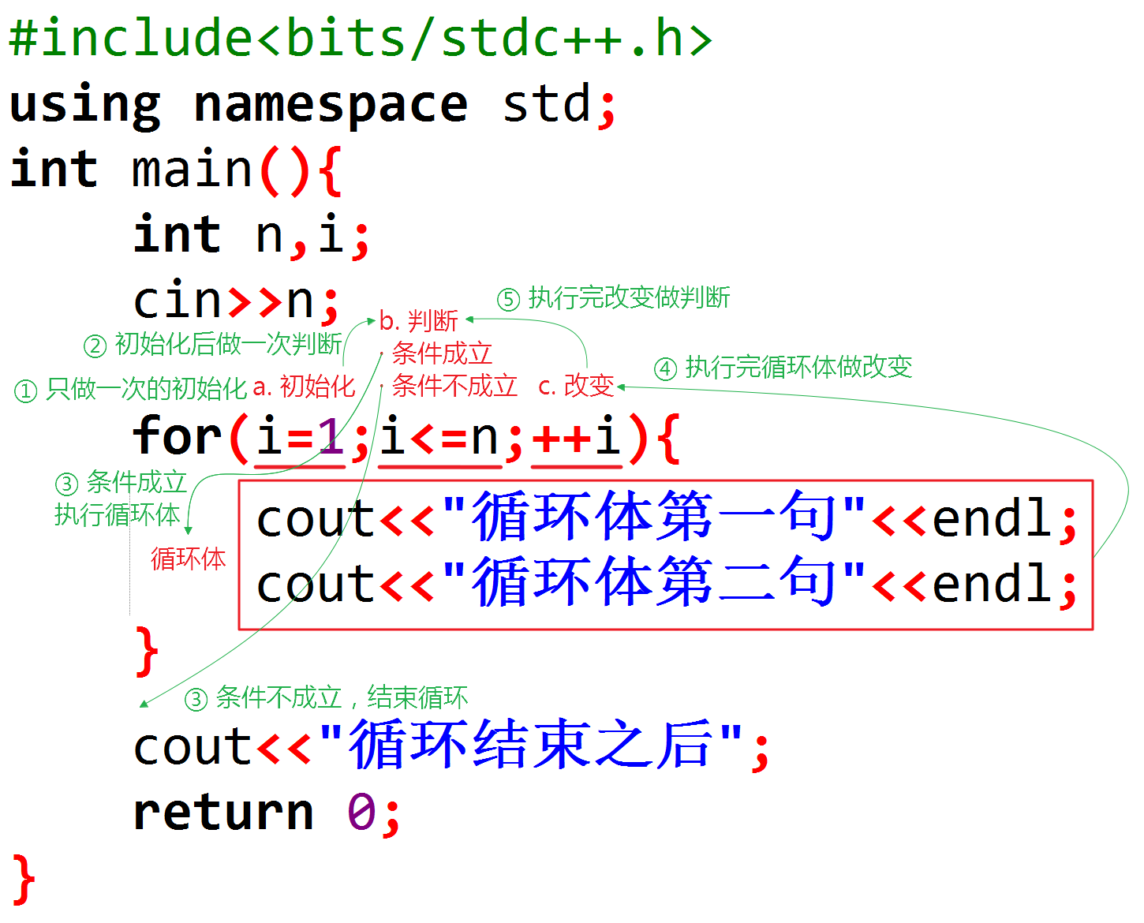
For-loop: Execution process
The loop control section is enclosed in parentheses and separated into three parts by two semicolons.
Execution process:
  Perform initialization
  Execution judgment
    If true, execute the loop body.
    If the condition is not met, terminate the loop.
  Implement changes
  Repeat b and c
If the loop body contains multiple statements, curly braces must be added.
Initialization will always be executed once; the loop body executes as many times as changes are made.
Indentation is usually added to the loop body to make the program easier to understand.
Do not add a semicolon after

Slide 5
Variable table
Console input 5
#include<bits/stdc++.h>
using namespace std;
int main(){
int n, i;
cin >> n;
for (i = 1; i <= n; ++ i)
cout << "Day "<< i << " : " << i*2 << endl;
return 0;
}
As time goes on, variables will change. Use a variable table to observe the value of the variable at a specific moment during each execution of the loop body.
Number of times run | Console output | i change | Condition
1 | Day 1 : 2​ | Change from 1 to 2 | satisfy
2 | Day 2 : 4​ | Change from 2 to 3 | satisfy
3 | Day 3 : 6​ | Change from 3 to 4 | satisfy
4 | Day 4 : 8​ | Change from 4 to 5 | satisfy
5 | Day 5 : 10​ | Change from 5 to 6 | Not satisfied

Slide 6
Self-increment, self-decrement
int a = 10;
a ++;
cout << a;
The following two statements have the same effect:
  a ++;
  a = a + 1;
Similarly, the following two sentences have the same effect:
  a --;
  a = a - 1;
The difference between
  If written separately, the effect is exactly the same.
  If it is included in the expression for calculation:
    ++a will increment first and then participate in the calculation.
    a++ will be used for calculation first and then incremented.
Output 11
int a = 10;
a --;
cout << a;
Output 9

Slide 7
Composite arithmetic assignment
int a = 10;
a += 5;
cout << a;
Composite arithmetic assignment | expression | Effect description
+= | x += 5 | x = x + 5
-= | x -= 5 | x = x – 5
*= | x *= 5 | x = x * 5
/= | x /= 5 | x = x / 5
%= | x % = 5 | x = x % 5
Output 15

Slide 8
For syntax explanation
#include<bits/stdc++.h>
using namespace std;
int main(){
int i, j;
for(i = 0, j = 10; i < j; ++i, --j)
cout << i << " " << j << endl;
return 0;
}
Output:
0 10
1 9
2 8
3 7
4 6
Initialisation can consist of multiple statements, separated by commas;
Changes can also be written in multiple statements, separated by commas;
Initialisation, conditions, and changes can each be omitted, or even all, but the two semicolons cannot be omitted;
Omitting the condition implies that the condition is always true;
#include<bits/stdc++.h>
using namespace std;
int main(){
int i = 0, j = 10;
for (; i < j; ){
cout << i << " " << j << endl;
++ i , -- j;
}
return 0;
}
Output:
0 10
1 9
2 8
3 7
4 6

Slide 9
Example - Sum of Odd and Even Numbers
Problem Description
#include<bits/stdc++.h>
using namespace std;
int main(){
int n, m, sum1=0, sum2=0;
cin >> n >> m;
for(int i=n; i<=m; ++i)
if(i % 2)
sum1 += i;
else
sum2 += i;
cout << sum1 << " " << sum2;
return 0;
}
#include<bits/stdc++.h>
using namespace std;
int main(){
int n, m, sum1=0, sum2=0;
cin >> n >> m;
for(int i=n, j=n+1; j<=m; i+=2, j+=2){
sum1 += i;
sum2 += j;
}
cout << sum1 <<" "<< sum2;
return 0;
}
Given integers n and m, calculate the sum of odd numbers from n to m, and the sum of even numbers.
Input
Two space-separated integers n and m (1 < n < m ≤ 1000, and n is guaranteed to be odd and m is guaranteed to be even).
Output
Two space-separated integers, the first being the sum of even numbers and the second being the sum of odd numbers.
Sample input:
1 100
Sample output:
2500 2550
The loop body is executed m-n+1 times .
The loop body is executed (m-n+1)/2 times .

Slide 10
Example: Five-digit numbers with special properties
Problem Description
#include<bits/stdc++.h>
using namespace std;
int main(){
for (int i=10000; i<100000; i++){
int a, b, c, d, e;
a = i%10;
b = i/10%10;
c = i/100%10;
d = i/1000%10;
e = i/10000;
if (a && b && c && d && e
&& a+c+e == b+d && a*c*e == b*d)
cout << i << " ";
}
return 0;
}
There is a class of five-digit numbers that satisfy the following property:
1. None of the digits is 0 ;
2. The 1st place plus the 3rd place plus the 5th place equals the 2nd place plus the 4th place;
3. Multiplying the 1st place by the 3rd place by the 5th place equals multiplying the 2nd place by the 4th place;
Output
Output all five-digit numbers that meet the requirements in ascending order, separated by single spaces.
Analysis
Five-digit numbers range from 10000 to 99999 ;
Starting with 10000 , check each five-digit number in ascending order, and output the result if it meets the condition.
Get each digit of a five-digit number x :
  1st place: x%10
  2nd place: x/10%10
  3rd place: x/100%10
  4th place: x/1000%10
  5th place: x/10000%10
  Since the quotient of a five-digit number divided by 10000 is always a single-digit number, %10 can be omitted.

Slide 11
Example - Find the tallest person
Problem Description
#include<bits/stdc++.h>
using namespace std;
int main(){
int n, maxn = 0, x, i;
cin >> n;
for (i = 0; i < n; ++ i){
cin >> x;
if (maxn < x)
maxn = x;
}
cout << maxn;
return 0;
}
#include<bits/stdc++.h>
using namespace std;
int main(){
int n, maxn, x, i;
cin >> n >> maxn;
for(i = 1; i < n; ++ i){
cin >> x;
if(maxn < x)
maxn = x;
}
cout << maxn;
return 0;
}
Given the heights of n students, find the tallest student .
Input
The first line contains an integer n (1 < n ≤ 100), representing the number of heights.
The second line contains n positive integers , each representing a height .
Note that maxn should be initialised to 0.
Directy input the first number into maxn.
The loop body is executed n times.
The loop body is executed n-1 times.
Output
One integer representing the height of the tallest student.
Sample input:
5
135 142 132 140 139
Sample output:
142
Analysis
Use a " challenge " method to find the maximum value.
First, define a champion variable maxn, and initialise it to a very small value that will always lose to all input numbers.
Each number challenges the champion: if the new number is greater than the champion, the new number wins the challenge and replaces the original champion; otherwise, the challenge fails, and the champion remains unchanged.
The following operatons are repeated n times:
  Input a number
  Let this number challenge maxn.
Therefore, it can be placed in a loop as the loop body, and the loop body can be executed n times.
Think:
If we are looking for the minimum value, how should we proceed?
What if we want to find the average?

Slide 12
Thank you everyone.
Note: Please turn off your microphone and camera.
Teacher Gao's Algorithm Competition Training Camp

Slide 13
Example - Output all even positive integers <= 100
#include<bits/stdc++.h>
using namespace std;
int main(){
int i;
for(i = 1; i <= 100; ++ i)
if(i%2 == 0)
cout << i << " ";
return 0;
}
#include<bits/stdc++.h>
using namespace std;
int main(){
int i;
for (i = 2; i <= 100; i += 2)
cout << i << " ";
return 0;
}
#include<bits/stdc++.h>
using namespace std;
int main(){
int i;
for (i = 1; i <= 50; ++ i)
cout << i*2 << " ";
return 0;
}
The loop body is executed 100 times .
The loop body is executed 50 times .
The loop body is executed 50 times .

Slide 14
Example - Fibonacci Sequence
#include<bits/stdc++.h>
using namespace std;
int main(){
int n, f2 = 1, f1 = 1, f, i;
cin >> n;
if (n < 3)
cout << 1;
else{
for(i = 3; i <= n; ++ i){
f = f2 + f1;
f2 = f1;
f1 = f;
}
cout << f;
}
return 0;
}
How many times? Execute the loop body | i | f | f2 | f1 | i change
1 | 3 | ?→2 | 1→1 | 1→2 | 3→4
2 | 4 | 2→3 | 1→2 | 2→3 | 4→5
3 | 5 | 3→5 | 2→3 | 3→5 | 5→6
4 | 6 | 5→8 | 3→5 | 5→8 | 6→7
5 | 7 | 8→13 | 5→8 | 8→13 | 7→8
The loop body is executed n-3+1 times.

